Slide 1

OTT MERGER ANALYSIS
LioCinema + Jotstar → LioJotstar

Slide 2
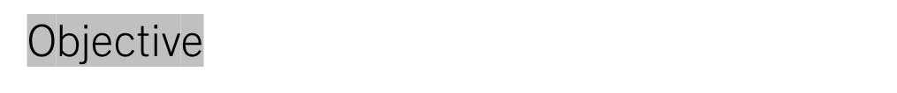
• Two major OTT platforms – LioCinema and Jotstar – merged to form LioJotstar
• 🎯 Objective: Analyze user engagement, subscription trends, content performance, and business impact post-merger
• 🛠️ Tools Used: Power BI, DAX, Power Query
• 📂 Dataset: Synthetic data (Subscribers, Contents, Consumption)

Slide 3



Slide 4
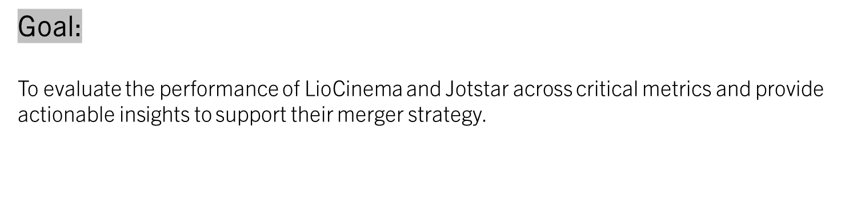

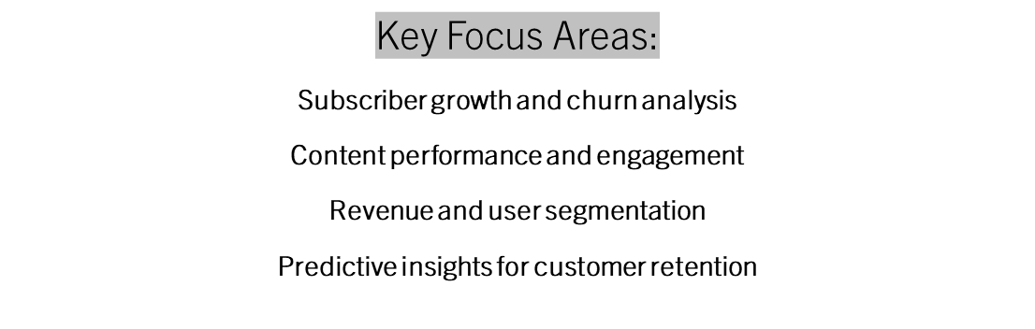

Slide 5
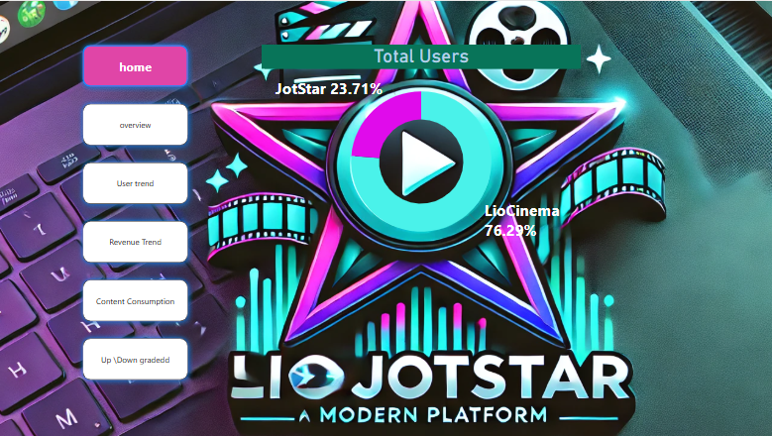

Slide 6
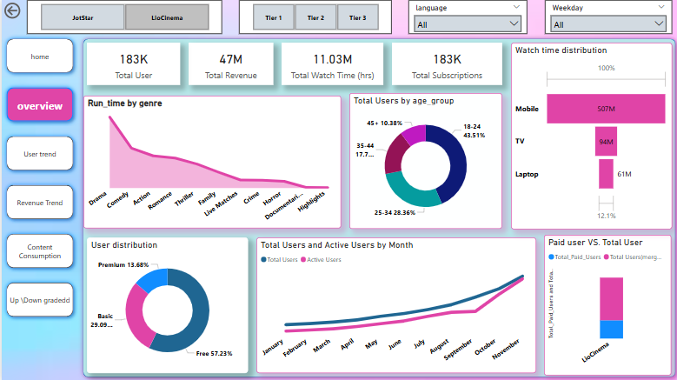

Slide 7
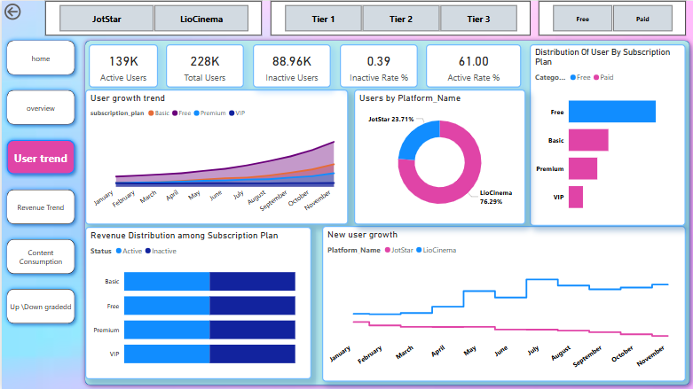

Slide 8
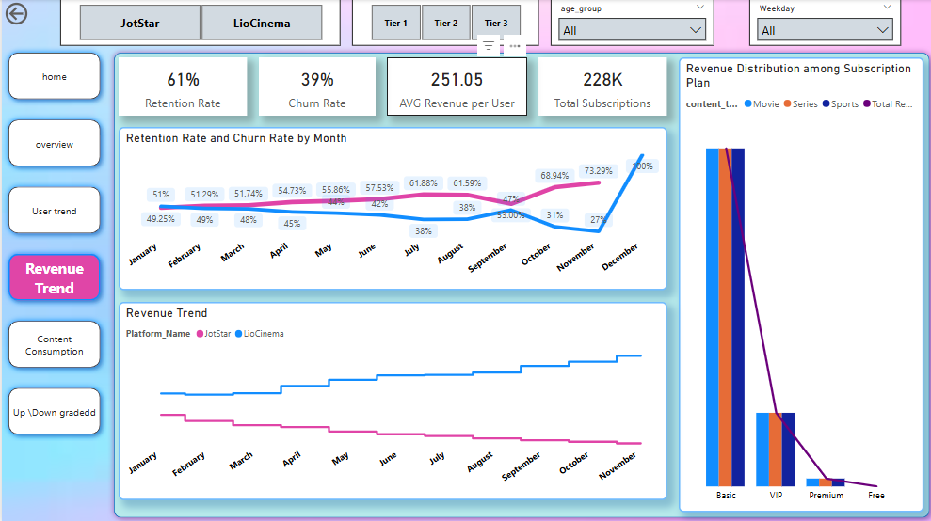

Slide 9
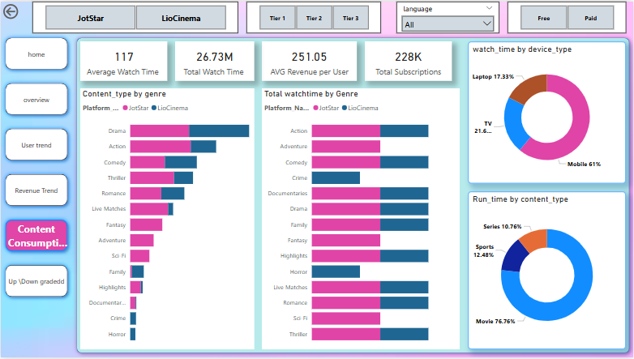

Slide 10
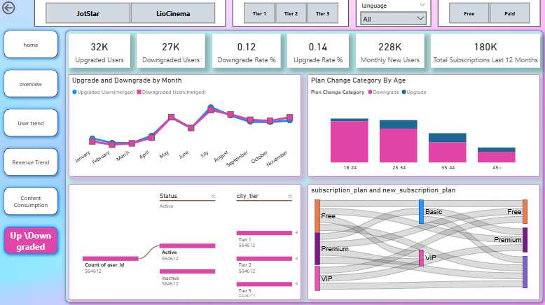

Slide 11
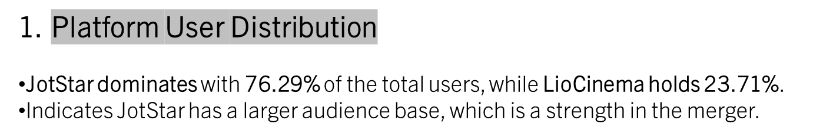
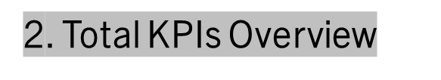
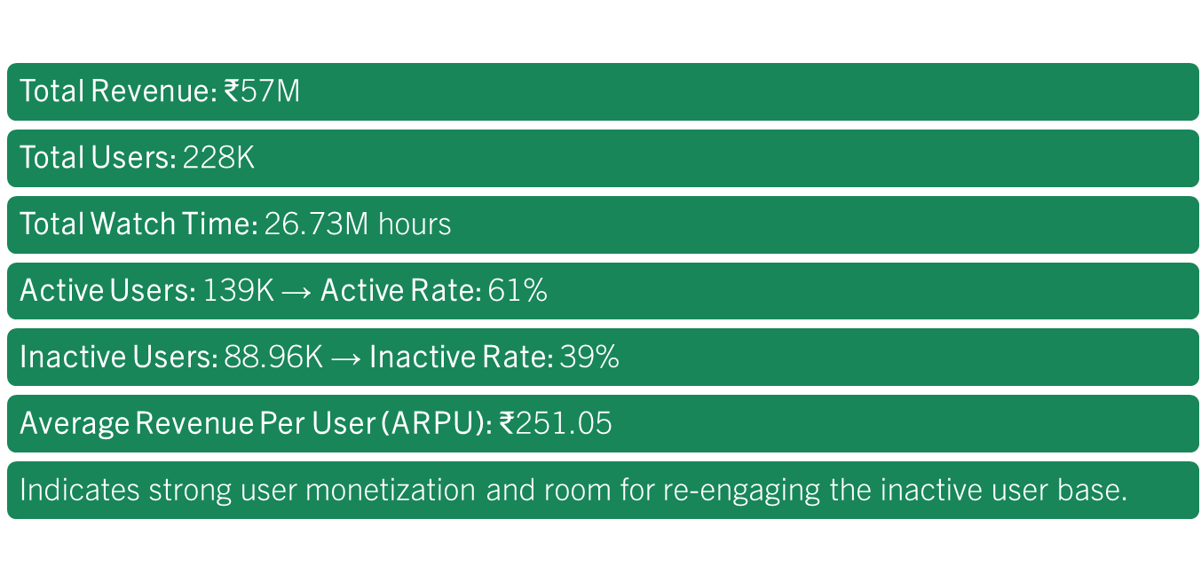

Slide 12
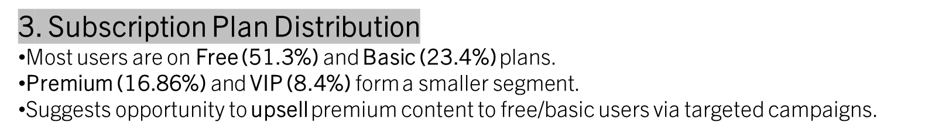
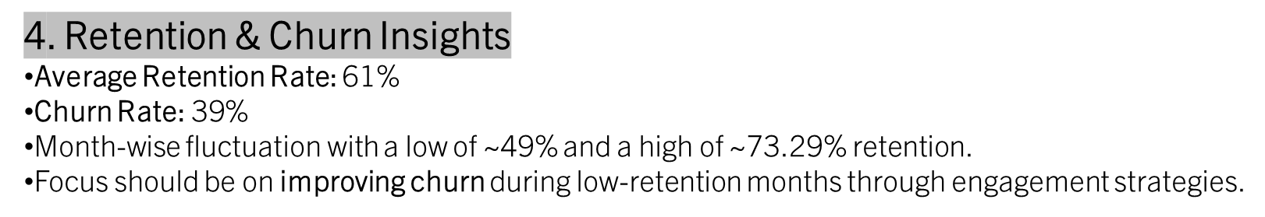
5. Demographic Distribution
Majority of users are aged 25-34 (38.3%), followed by 18-24 (31.61%)
Least representation from 45+ (10.81%)
Tailor content & campaigns around younger age groups to improve engagement and growth.

Slide 13
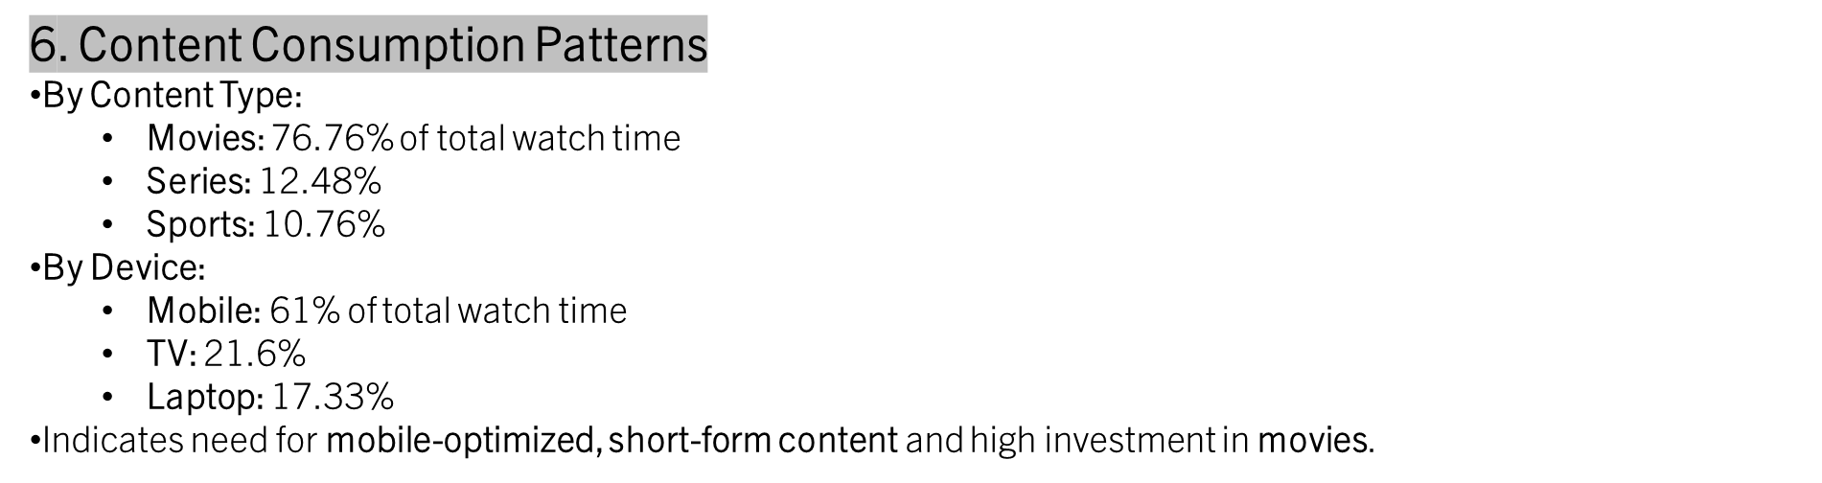
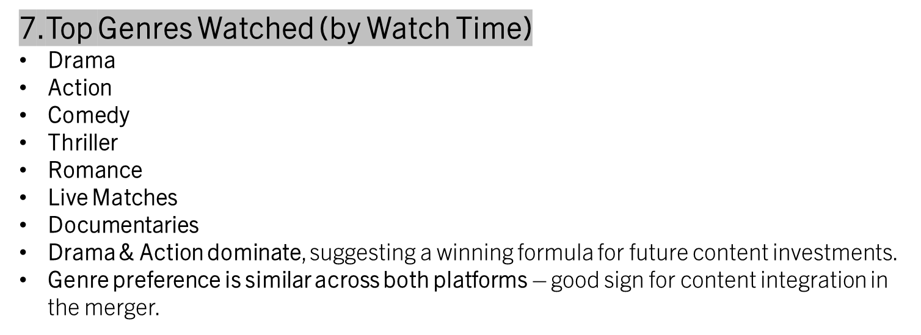

Slide 14
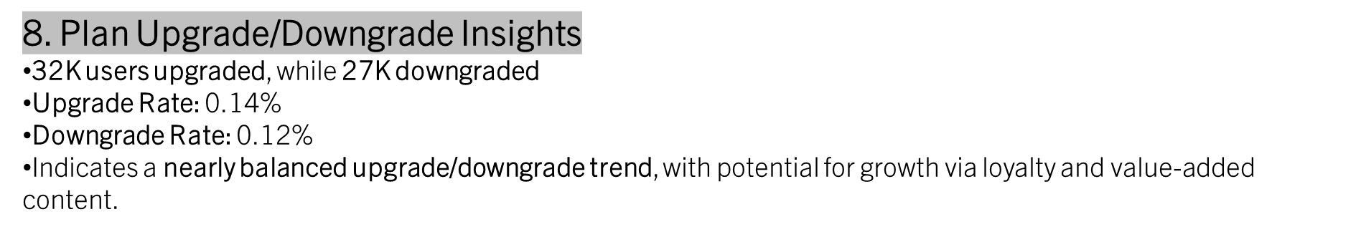
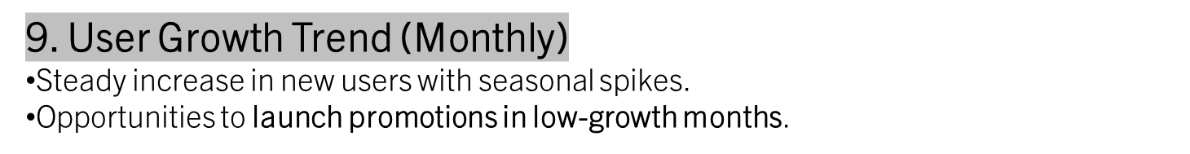

Slide 15
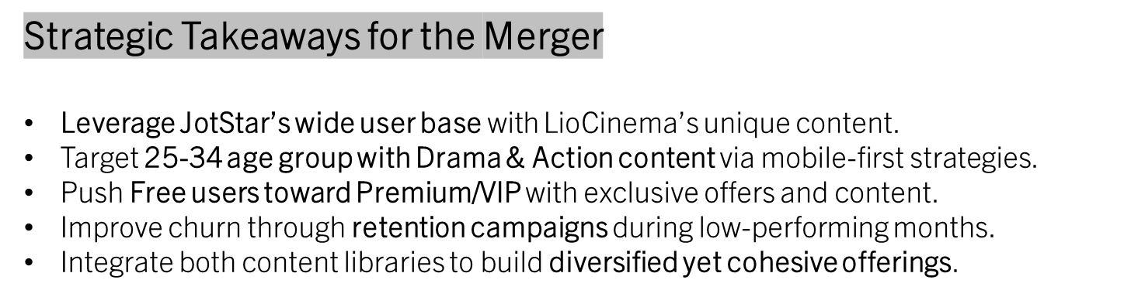

Slide 16
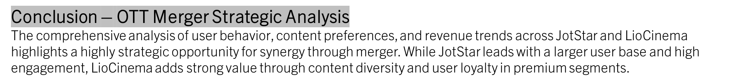
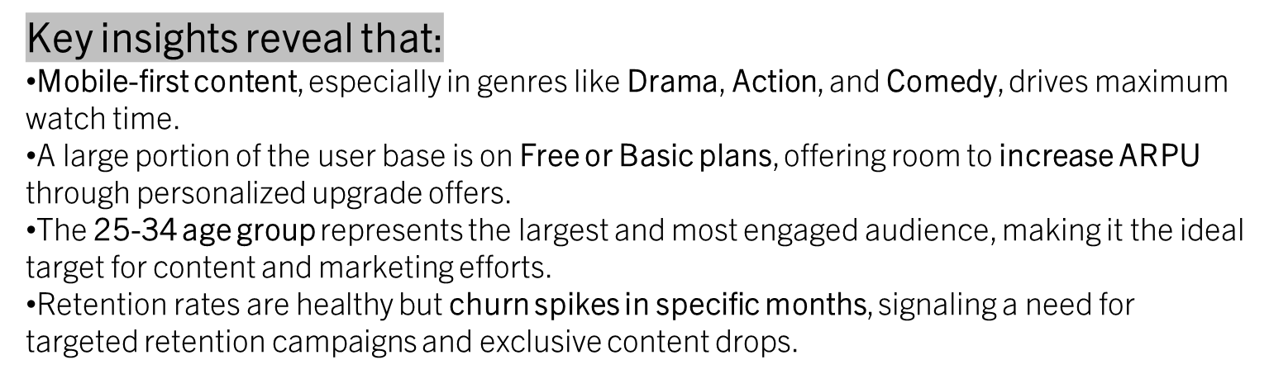
By leveraging JotStar’s scale and LioCinema’s premium appeal, the merged platform can optimize user acquisition, engagement, and monetization. Data-driven content investments, dynamic pricing strategies, and predictive churn modeling will be crucial in sustaining growth and competitive edge in the OTT space

Slide 17




